Slide 1
Maps
Key-Value pairings

Slide 2
Map ADT
The Fundamentals of a Map

Slide 3
What is a Map?
Maps are data structures that store data as a pairing – a key and its value.
Value is mapped to a specific key
Key and value don’t need to be the same type of thing
To search for a value, provide the key
Map will look through its data to find the value mapped to that key
Relationship between the key and its value is known as the mapping
Mappings are usually 1:1
Key | Value
Alvin | 084-7789534
Simon | 082-5412569
Theodore | 085-7548123
Bow | 086-8794582
Glimmer | 087-7852164
Razz | 085-8954671
We are very familiar with these – python’s dict!

Slide 4
Using a Map
Maps are based on two components
The key
The value
Need both the key and the value to add a new entry to a map
put(key, value)
Only need the key to search for a mapping (value)
get(key)
Only need the key to remove a mapping (value)
remove(key)
Note the importance of the key here! What would happen if the key changed after you inserted it into the map?

Slide 5
Fundamental Data Storage for a Map
Maps are based on two components
The key
The value
Must be able to store multiple of both within the map
Can be implemented in a few ways, e.g.:
Parallel arrays
Single array of Entry<K, V>* objects
K: key
V: value
Notes:
*<K, V> is the generic notation. You could also say Entry<String, User> to create an Entry that holds a String as the key and a User as the value, or Entry<String, ContactInfo> to create an Entry that holds a String (the name) as the key and a ContactInfo object as the value.

Slide 6
Fundamental Operations for a Map
Add an element (put)
Remove an element
Search for/retrieve an element (get)
Check if a key is present
Get the keys in the map
Get the values in the map
Get the number of mappings in the map

Slide 7
Map ADT
put(k, v): Store Value v in the map based on Key k. If this key already exists in the map, overwrite the old value with this new one, and return the old value.
Input: Key, Value
Output: Value (if key was already present) or null (if nothing was found matching that key)
remove(k): Remove the Value mapped to the supplied Key k, as well as the Key itself from the map. If the Key is found in the map, return the old Value (that was deleted). If the Key is not found, return null.
Input: Key
Output: Value (if that Key was found in the map) or null (if nothing was found matching that Key)

Slide 8
Map ADT
containsKey(k): Check if Key k is present in the map.
Input: Key
Output: True/False
get(k): Search for the Key k in the map. If k is present, return the Value mapped to the supplied Key k. If the Key is not found, return null.
Input: Key
Output: Value (if that Key was found in the map) or null (if nothing was found matching that Key)
size(): Return the number of Key-Value mappings stored in the map.
Input: None
Output: Integer

Slide 9
Map ADT
getKeys(): Get all Keys in the map
Input: None
Output: Data Structure of Keys
getValues(): Get all Values in the map
Input: None
Output: Data Structure of Values

Slide 10
Where to Use a Map
When you are retrieving data frequently based on key information (lots of searching)
Not useful for:
Retrieving information in sorted order
Maps store data the same way all the time, can’t re-order
Iterating / traversing through information
Keys are not numbers to be iterated over
Spaces in a map are not filled in order, gaps occur
Processing in the order you received the data
Information is not stored in sequential order, once it goes into a map it loses its “place” in sequence
When using a map, it’s important that the key is immutable, i.e. it cannot be changed internally
Tip: Strings are automatically immutable

Slide 11
Implementing the Map ADT
HashMaps/Tables

Slide 12
Approaches to Map Implementation
Multiple ways to implement Maps, e.g.:
Simplistic: Parallel arrays - one array for keys, one array for values
Common: Single array of Entry objects (Entry contains Key and Value data)
Variant: Single array of Value objects (where the Value is also used as the key)
In all cases, we need to decide which slot should store the data when adding
Solution: hash (turn its data into a number) the key and put it in that slot in the array
Known as a hash map (where a separate key exists) or a hash table (where the value is used as the key)
API versions:
HashMap, HashTable

Slide 13
Implementing a Hash Map as a Class
Two components to a Hash Map:
Array of Entry objects
Entry: A way to bind a key and a value together into one object
Count of how many mappings / key-value pairs in the map

Slide 14
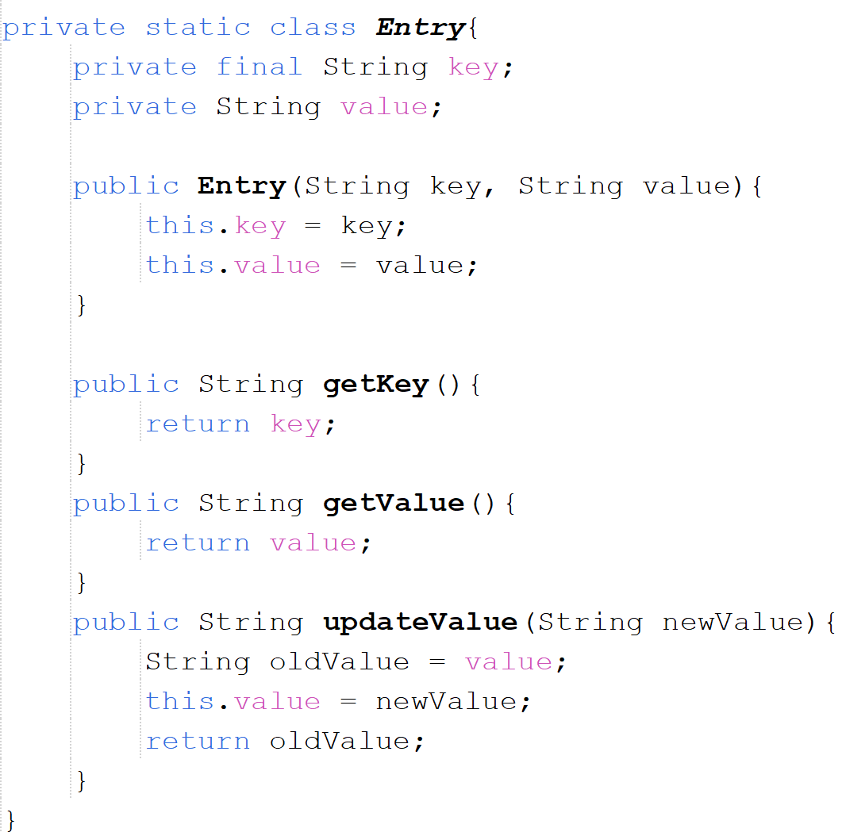
Entry Objects: The Components Within Hash Maps
Entry class: a private static inner class of Hash Map
Similar to Node in LinkedList – this is a wrapper class the Hash Map class will use to bundle data together.
Made up of:
A Key (final) & a Value (changeable)
A constructor
Getters for Key and Value
Setter for Value
What if it was a generic map?

Slide 15
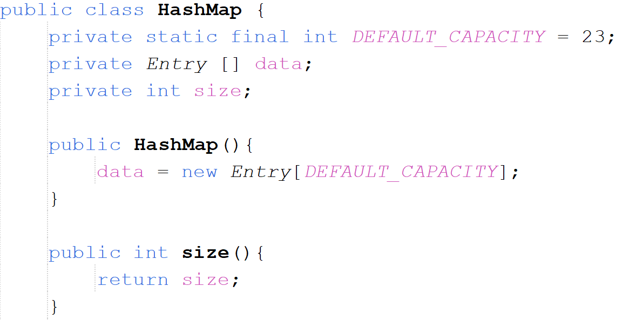
Implementing a Hash Map as a Class
Basic structure of a Hash Map:
Make an array of Entry objects with a size equal to the default capacity
The capacity of the map impacts more than how many things can be stored!

Slide 16
Adding to a Hash Map – Picking a Slot
Most complicated part of Hash Maps is working out where to store data
Need to pick a slot from all the available ones in the map
We do this using a hash function
Hash function turns the key’s data into a number
Same as what hashCode does for an Object
Hash of the key can result in a number greater than the size of the array – what then?
Mod (%) the hash by the size of the array
Use the result of the mod as the slot index / to pick the slot
hash % arraySize = destinationSlotIndex

Slide 17
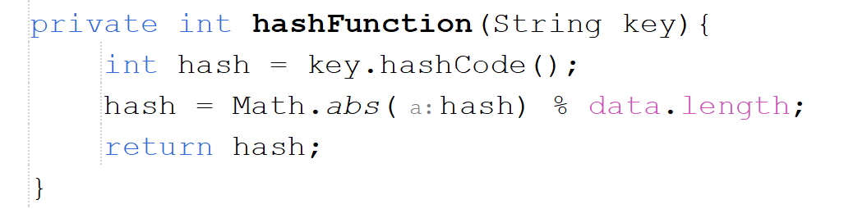
Implementing Slot Selection
Pseudocode:
Hash the key to generate numeric value
Mod the absolute value of the hash to calculate array slot index and return it
Absolute value is used to avoid calculating mod of a negative number
We code this as a specific method so:
It can be easily overridden by subclasses (To change how they decide on where to store data)
We guarantee that the same logic will be used by the put and get methods

Slide 18
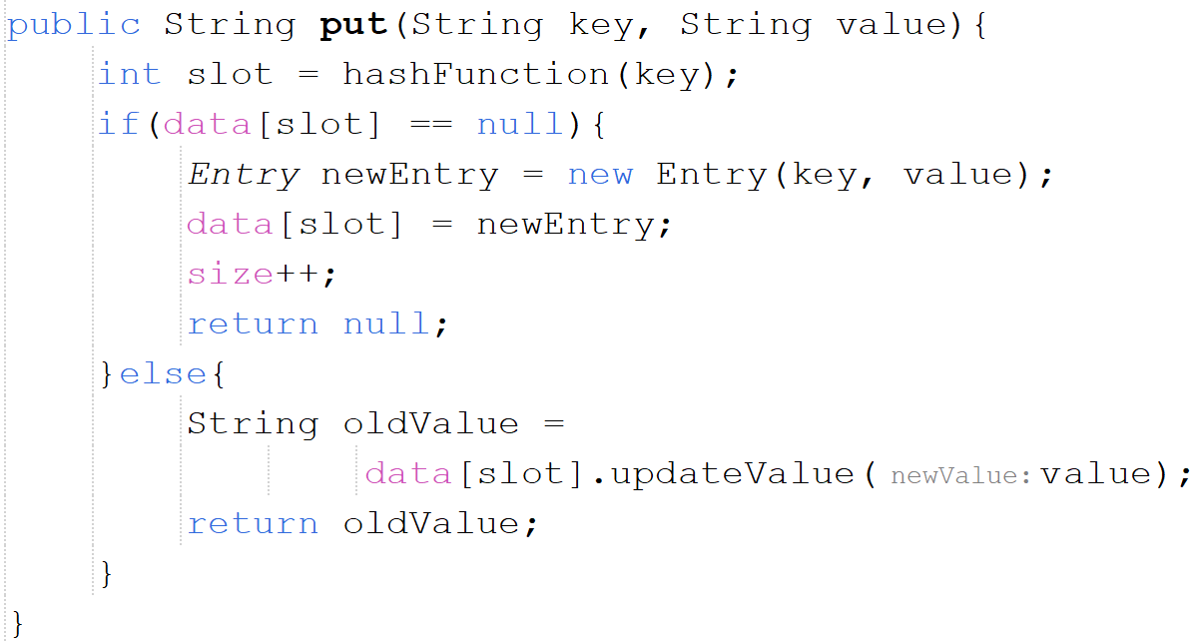
Implementing put (add) Functionality
Pseudocode:
Calculate the array slot index to be used for this new value
Check if the slot is empty
If it is
Create an entry
Add it to that slot
Increase the size count (due to new mapping)
Return null
If it’s not:
Save the old value in the current entry
Update the value within the entry
Return the old value

Slide 19
More on Slot Selection
The hash function has a lot of power
It dictates in which slot within the map’s array data will be stored/located
This relies on two things:
Every key having a unique hash AND
The mod of that hash being unique
What happens if two keys generate the same hash? Or two hashes mod to the same value?
Collisions!

Slide 20
Hash Tables
A subtle variation on a map

Slide 21
What About Hash Tables?
A Hash Table is a special version of a Map
Though the terms are often used interchangeably with no distinction at all!
Instead of storing a key AND a value, a Hash Table just stores a value
The value acts as its own key
Hash Tables perform the same general steps as Hash Maps when adding a new element
Calculate a hash of the key (in this case, the object being stored/the value)
Check if the slot corresponding to the calculated hash is available
Add it to that slot if it is
HashTables can be generic (like Hash Maps) – public class MyHashTable<T>
A generic HashTable relies on the hashCode of the Value (object) being stored
A generic HashMap relies on the hashCode of the Key mapped to the Value being stored

Slide 22
Hash Tables vs Hash Maps
Benefit of Hash Tables (over Hash Maps) :
Less space costs – why?
Drawback of Hash Tables (over Hash Maps):
Your stored objects themselves should be immutable – why?

